Slide 1
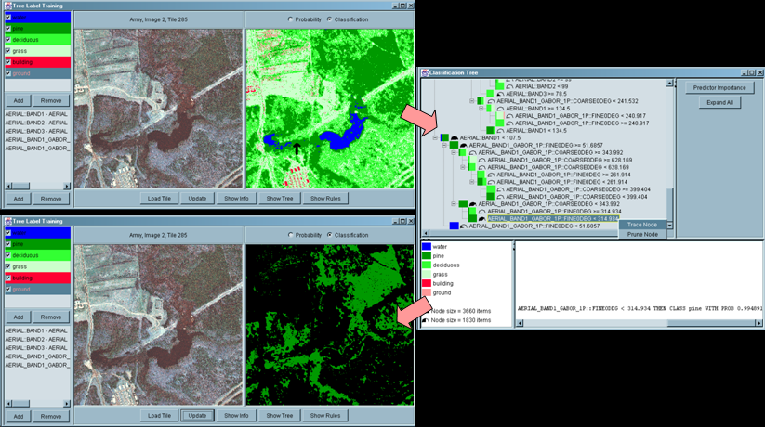
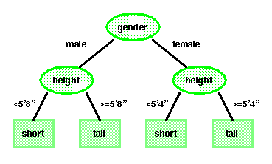

LECTURE 18: DECISION TREES
Objectives: Tree-Growing Via CART Splitting, Stopping and Pruning Attributes Node Impurity Priors and Costs
Resources: DHS: Chapter 8 WIKI: Definitions AAAI: Decision Trees AM: Data Mining DTDM: Resources JB: Examples ISIP: Software
URL:
Audio:
Notes:
MS Equation 3.0 was used with settings of: 18, 12, 8, 18, 12.

Slide 2
Overview
Previous techniques have consisted of real-valued feature vectors (or discrete-valued) and natural measures of distance (e.g., Euclidean).
Consider a classification problem that involves nominal data – data described by a list of attributes (e.g., categorizing people as short or tall using gender, height, age, and ethnicity).
How can we use such nominal data for classification? How can we learn the categories of such data? Nonmetric methods such as decision trees provide a way to deal with such data.
Decision trees attempt to classify a pattern through a sequence of questions. For example, attributes such as gender and height can be used to classify people as short or tall. But the best threshold for height is gender dependent.
A decision tree consists of nodes and leaves, with each leaf denoting a class.
Classes (tall or short) are the outputs of the tree.
Attributes (gender and height) are a set of features that describe the data.
The input data consists of values of the different attributes. Using these attribute values, the decision tree generates a class as the output for each input data.

Slide 3
Basic Principles
The top, or first node, is called the root node.
The last level of nodes are the leaf nodes and contain the final classification.
The intermediate nodes are the descendant or “hidden” layers.
Binary trees, like the one shown to the right, are the most popular type of tree. However, M-ary trees (M branches at each node) are possible.
Nodes can contain one more questions. In a binary tree, by convention if the answer to a question is “yes”, the left branch is selected. Note that the same question can appear in multiple places in the network.
Decision trees have several benefits over neural network-type approaches, including interpretability and data-driven learning.
Key questions include how to grow the tree, how to stop growing, and how to prune the tree to increase generalization.
Decision trees are very powerful and can give excellent performance on closed-set testing. Generalization is a challenge.

Slide 4
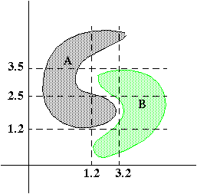
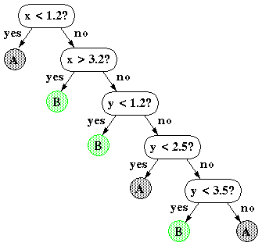
Nonlinear Decision Surfaces
Decision trees can produce nonlinear decision surfaces:
They are an attractive alternative to other classifiers we have studied because they are data-driven and can give arbitrarily high levels of precision on the training data.
But… generalization becomes a challenge.

Slide 5
Classification and Regression Trees (CART)
Consider a set D of labeled training data and a set of properties (or questions), T.
How do we organize the tree to produce the lowest classification error?
Any decision tree will successively split the data into smaller and smaller subsets. It would be ideal if all the samples associated with a leaf node were from the small class. Such a subset, or node, is considered pure in this case.
A generic tree-growing methodology, known as CART, successively splits nodes until they are pure. Six key questions:
Should the questions be binary (e.g., is gender male or female) or numeric (e.g., is height >= 5’4”) or multi-valued (e.g., race)?
Which properties should be tested at each node?
When should a node be declared a leaf?
If the tree becomes too large, how can it be pruned?
If the leaf node is impure, what category should be assigned to it?
How should missing data be handled?

Slide 6
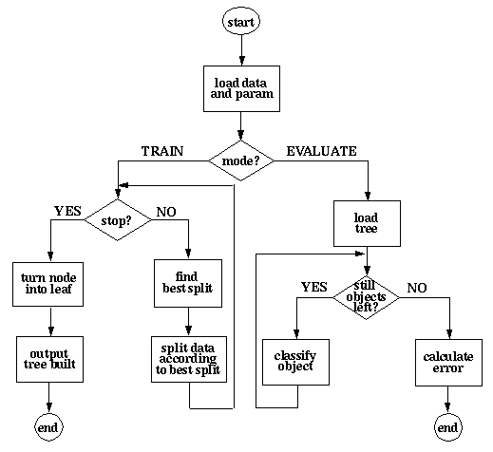
Operation

Slide 7
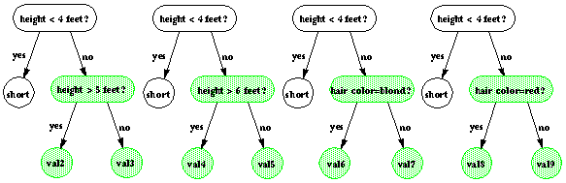
Entropy-Based Splitting Criterion
We prefer trees that are simple and compact. Why? (Hint: Occam’s Razor).
Hence, we seek a property query, T_{i}, that splits the data at a node to increase the purity at that node. Let i(N) denote the impurity of a node N.
To split data at a node, we need to find the question that results in the greatest entropy reduction (removes uncertainty in the data):
Note this will peak when the two classes are equally likely (same size).
Notes:
XOR: x_1, x_2, and we want to transform to x_1^2, x_2^2, x_1 x_2
It can also be viewed as feature extraction from the feature vector x, but now we extract more feature than the number of features in x.

Slide 8
Alternate Splitting Criteria
Variance impurity:
because this is related to the variance of a distribution associated with the two classes.
Gini Impurity:
The expected error rate at node N if the category label is selected randomly from the class distribution present at node N.
Misclassification impurity:
measures the minimum probability that a training pattern would be misclassified at node N.
In practice, simple entropy splitting (choosing the question that splits the data into two classes of equal size) is very effective.
Notes:
XOR: x_1, x_2, and we want to transform to x_1^2, x_2^2, x_1 x_2
It can also be viewed as feature extraction from the feature vector x, but now we extract more feature than the number of features in x.

Slide 9
Choosing A Question
An obvious heuristic is to choose the query that maximizes the decrease in impurity:
where N_{L} and N_{R} are the left and right descendant nodes, i(N_{L}) and i(N_{R}) are their respective impurities, and P_{L} is the fraction of patterns at node N that will be assigned to N_{L} when query T_{i} is chosen.
This approach is considered part of a class of algorithms known as “greedy.”
Note this decision is “local” and does not guarantee an overall optimal tree.
A multiway split can be optimized using the gain ratio impurity:
where P_{k} is the fraction of training patterns sent to node N_{k}, and B is the number of splits, and:
Notes:
XOR: x_1, x_2, and we want to transform to x_1^2, x_2^2, x_1 x_2
It can also be viewed as feature extraction from the feature vector x, but now we extract more feature than the number of features in x.

Slide 10
When To Stop Splitting
If we continue to grow the tree until each leaf node has the lowest impurity, then the data will be overfit.
Two strategies: (1) stop tree from growing or (2) grow and then prune the tree.
A traditional approach to stopping splitting relies on cross-validation:
Validation: train a tree on 90% of the data and test on 10% of the data (referred to as the held-out set).
Cross-validation: repeat for several independently chosen partitions.
Stopping Criterion: Continue splitting until the error on the held-out data is minimized.
Reduction In Impurity: stop if the candidate split leads to a marginal reduction of the impurity (drawback: leads to an unbalanced tree).
Cost-Complexity: use a global criterion function that combines size and impurity: . This approach is related to minimum description length when the impurity is based on entropy.
Other approaches based on statistical significance and hypothesis testing attempt to assess the quality of the proposed split.
Notes:
XOR: x_1, x_2, and we want to transform to x_1^2, x_2^2, x_1 x_2
It can also be viewed as feature extraction from the feature vector x, but now we extract more feature than the number of features in x.

Slide 11
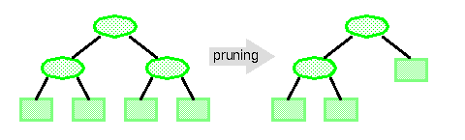
Pruning
The most fundamental problem with decision trees is that they "overfit" the data and hence do not provide good generalization. A solution to this problem is to prune the tree:
But pruning the tree will always increase the error rate on the training set ☹.
Cost-complexity Pruning: . Each node in the tree can be classified in terms of its impact on the cost-complexity if it were pruned. Nodes are successively pruned until certain heuristics are satisfied.
By pruning the nodes that are far too specific to the training set, it is hoped the tree will have better generalization. In practice, we use techniques such as cross-validation and held-out training data to better calibrate the generalization properties.
Notes:
XOR: x_1, x_2, and we want to transform to x_1^2, x_2^2, x_1 x_2
It can also be viewed as feature extraction from the feature vector x, but now we extract more feature than the number of features in x.

Slide 12
ID3 and C4.5
Third Interactive Dichotomizer (ID3) uses nominal inputs and allows node-specific number of branches, B_{j}. Growing continues until all nodes as pure.
C4.5, the successor to ID3, is one of the most popular decision tree methods:
Handles real-valued variables;
Allows multiway splits for nominal data;
Splitting based on maximization of the information gain ratio while preserving better than average information gain;
Stopping based on node purity;
Pruning based on confidence/average node error rate (pessimistic pruning).
Bayesian methods and other common modeling techniques have been successfully applied to decision trees.

Slide 13
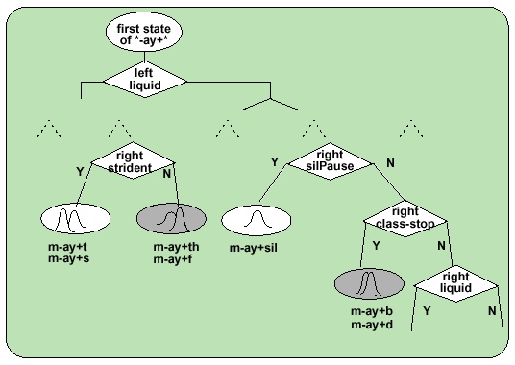
Example Application: Parameter Tying
Decision trees are popular for many reasons including their ability to achieve high performance on closed-set evaluations.
They can be closely integrated with hidden Markov models to provide a very powerful methodology for clustering and reducing complexity.
Consider the problem in speech recognition of context-dependent phonetic modeling, which can potentially involve ten thousand acoustic models.
On what basis should we cluster or reduce the number of acoustic models?
The questions can be drawn from linguistics (e.g., vowel, consonant, sibilant).
The tree growing process is intimately integrated into the Baum-Welch training process using the same likelihood calculations available during HMM parameter training.

Slide 14
Summary
A classification and regression tree (CART) algorithm can be summarized as follows:
Create a set of questions that consists of all possible questions about the measured variables (phonetic context).
Select a splitting criterion (likelihood).
Initialization: create a tree with one node containing all the training data.
Splitting: find the best question for splitting each terminal node. Split the one terminal node that results in the greatest increase in the likelihood.
Stopping: if each leaf node contains data samples from the same class, or some pre-set threshold is not satisfied, stop. Otherwise, continue splitting.
Pruning: use an independent test set or cross-validation to prune the tree.
There are ways to estimate and incorporate priors into the decision tree (though these methods somewhat predate Bayesian methods).
Decision trees can be used in many ways and closely integrated with other pattern recognition algorithms (e.g., hidden Markov models).
They can be used to control complexity in a system by supporting decisions about parameter tying.
Computational complexity is very low for both evaluation and training.

